Slide 1
BB2950 Day 14: Thursday 11-16-17
Learning objectives:
Explain how Illumina sequencing (a type of “next generation” sequencing) is used to sequence DNA (continued from Tues).

Slide 2
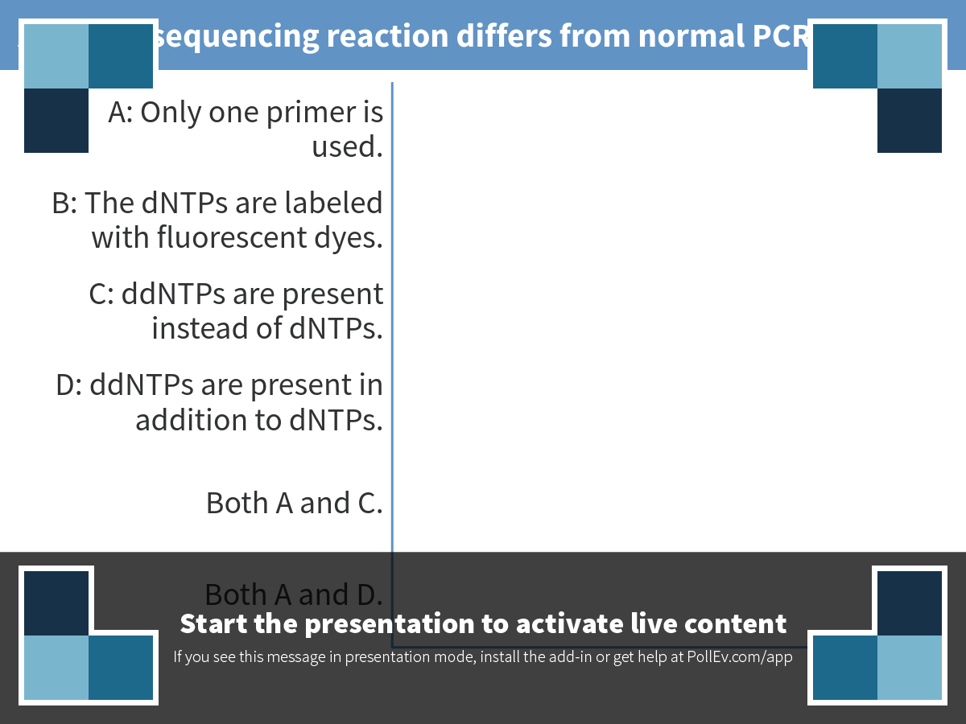
Notes:
A sanger sequencing reaction differs from normal PCR in that…
https://www.polleverywhere.com/multiple_choice_polls/WGAeO0Mzf3uquoT

Slide 3
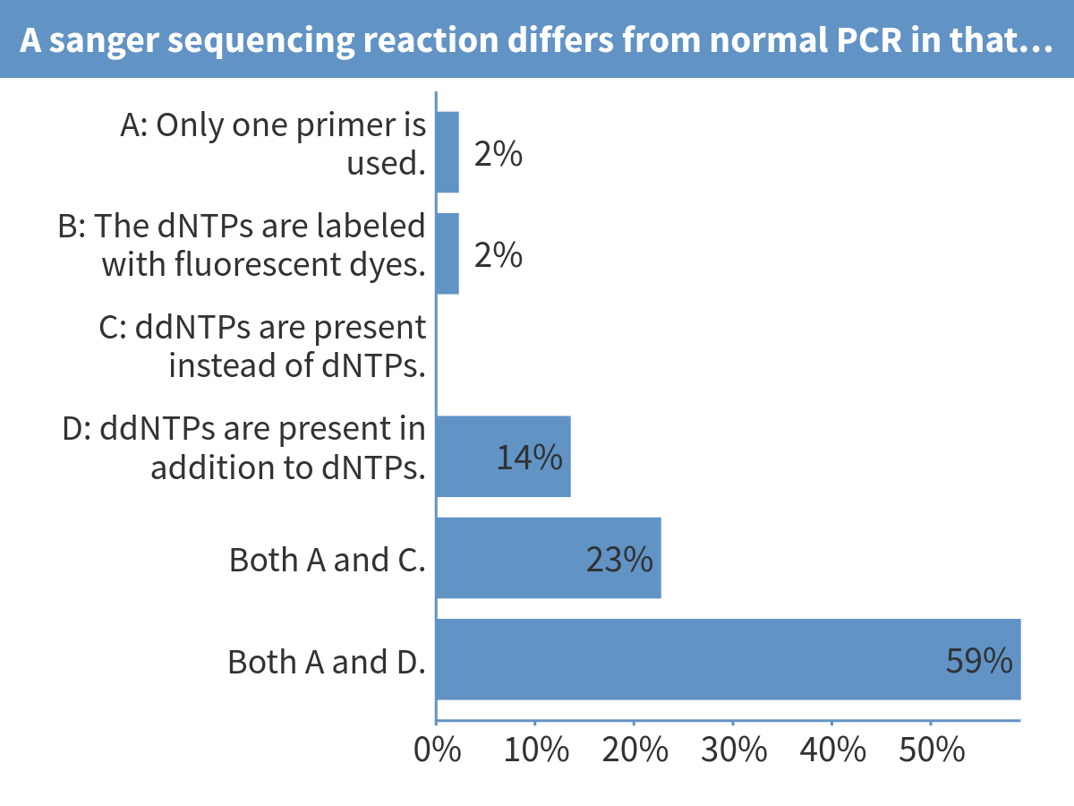
Notes:
A sanger sequencing reaction differs from normal PCR in that…

Slide 4
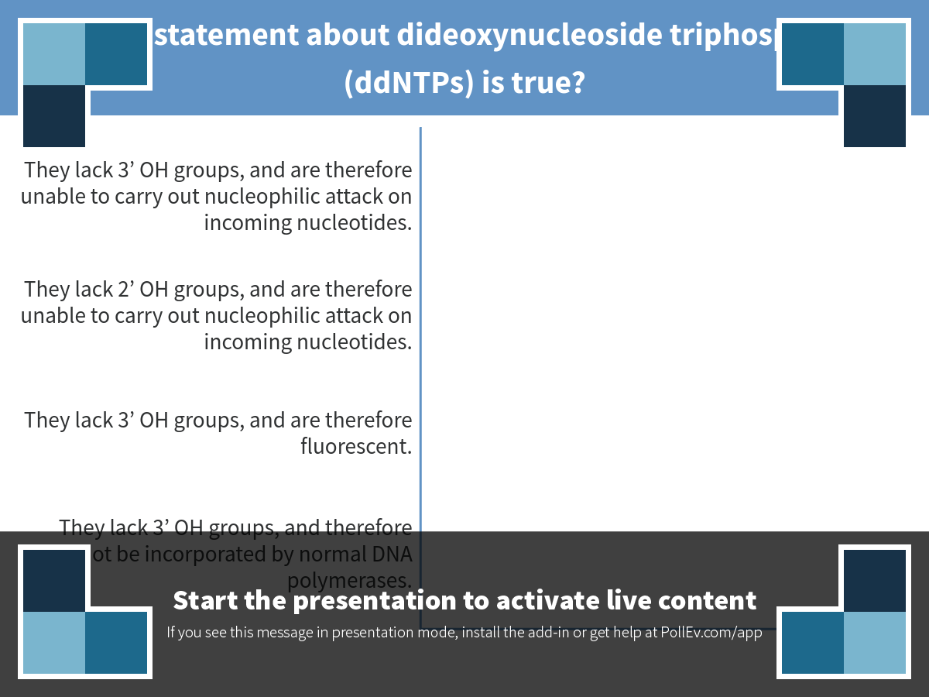
Notes:
Which statement about dideoxynucleoside triphosphates (ddNTPs) is true?
https://www.polleverywhere.com/multiple_choice_polls/s8ftB1AcIpIFfGd

Slide 5
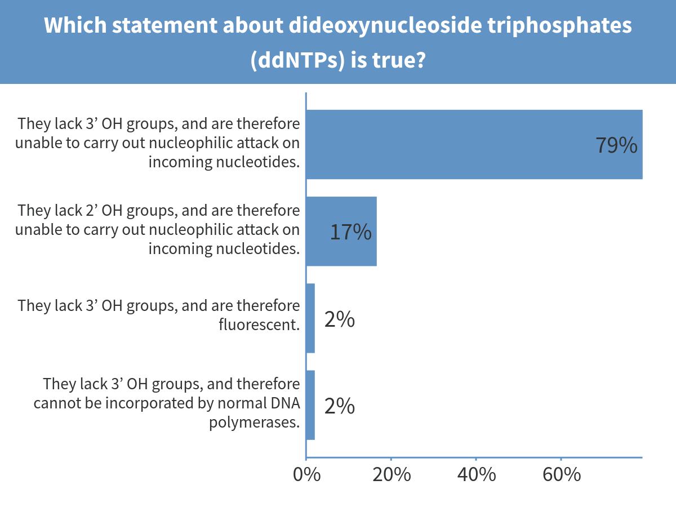
Notes:
Which statement about dideoxynucleoside triphosphates (ddNTPs) is true?

Slide 6
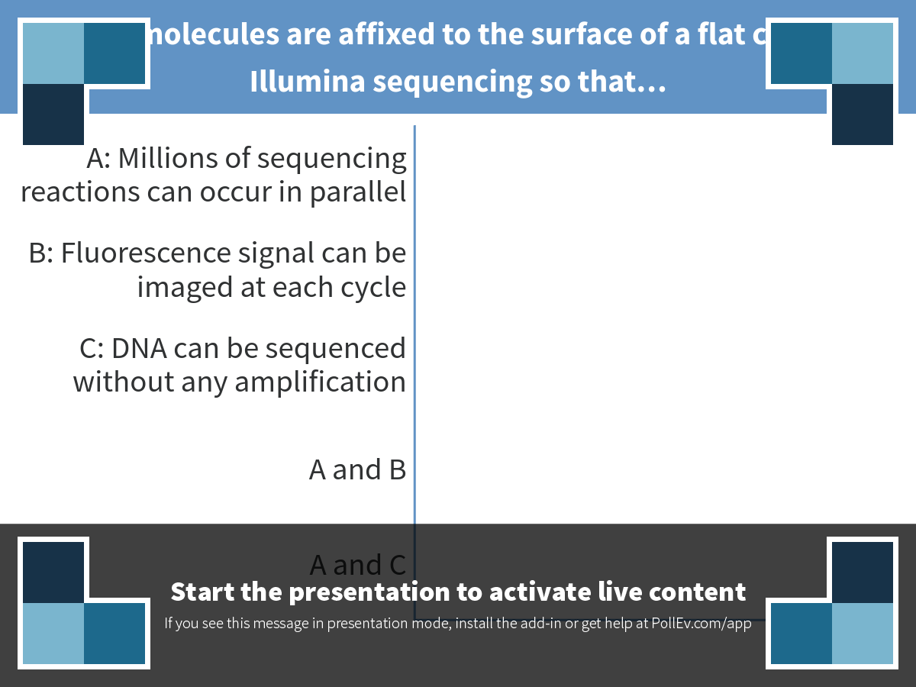
Notes:
DNA molecules are affixed to the surface of a flat chip in Illumina sequencing so that…
https://www.polleverywhere.com/multiple_choice_polls/MLEU5omAEZfVwpv

Slide 7
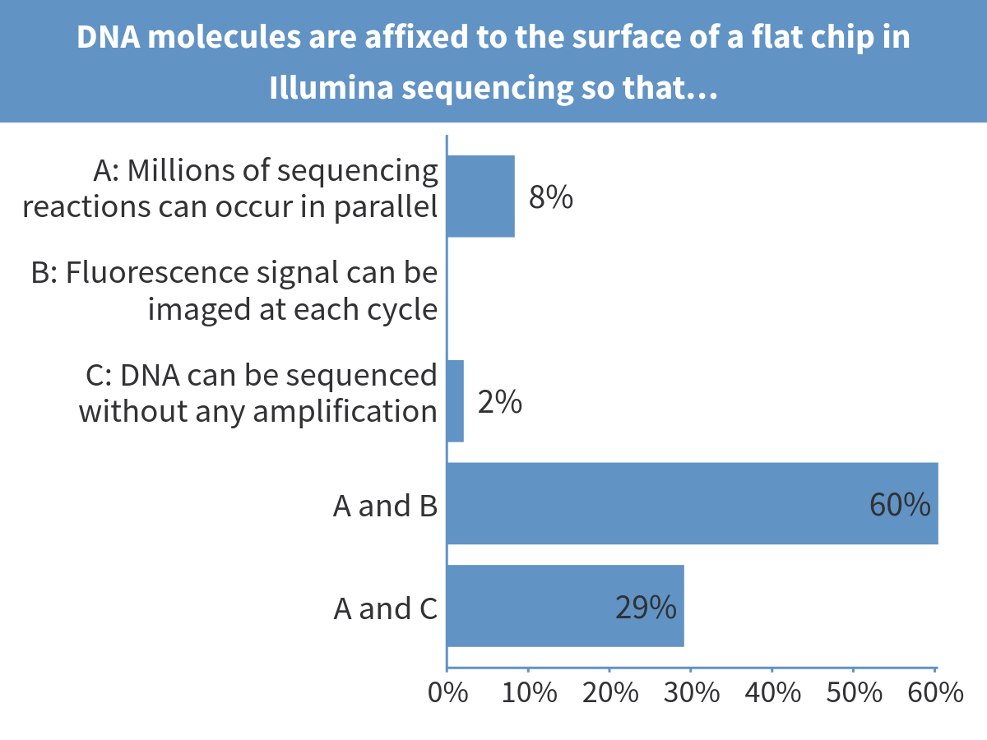
Notes:
DNA molecules are affixed to the surface of a flat chip in Illumina sequencing so that…

Slide 8
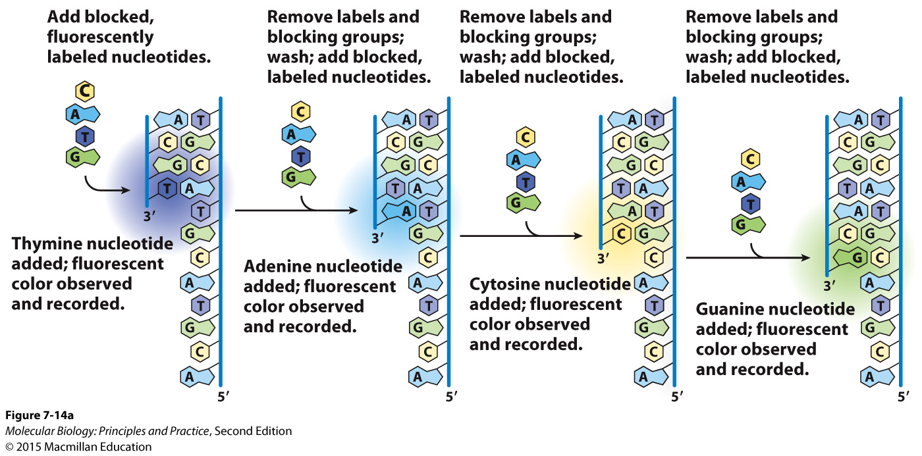
Modified nucleotide derivatives are used for Illumina sequencing

Slide 9
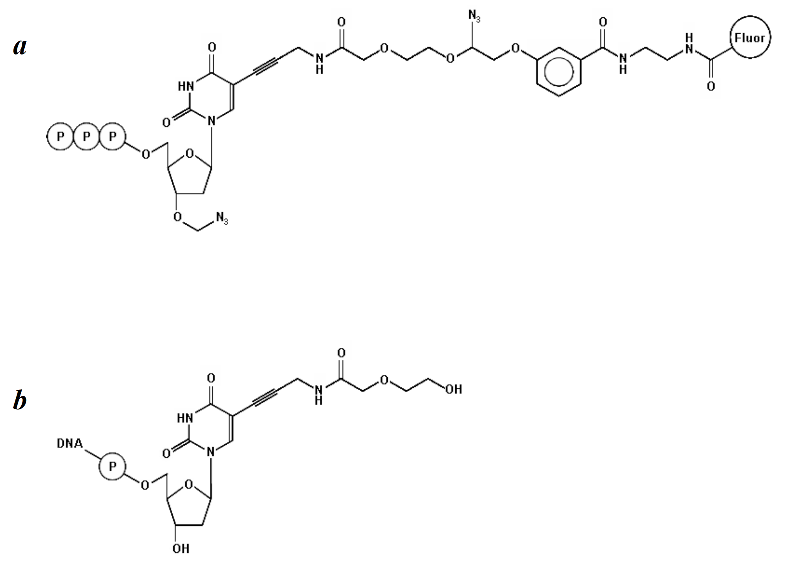
Modified nucleotides used for Illumina sequencing
Bentley et al. (2008). Nature, 456(7218), 53–59.

Slide 10
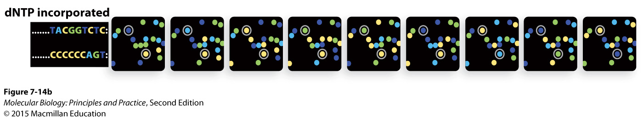
Clusters imaged at several consecutive cycles

Slide 11
Major steps in Illumina sequencing

Slide 12
Illumina sequencing reads aligned to a reference genome

Slide 13
Common uses of Illumina and other next-generation sequencing technologies
Sequence new genomes
Sequence genomes from individuals (or strains or cell lines or even single cells) to identify differences/mutations
(Measure gene expression – coming soon)

Slide 14
Why might you want to measure gene expression?

